Slide 1

7th Grade Math
Unit 3, Lesson 5 Solving Real-World Problems with Rational Numbers – Part 1 Volume 1, pg. 104

Slide 2


Benchmark
MA.7.NSO.2.3
Solve real-world problems involving any of the four operations with rational numbers.
volume 1, pg. 104

Slide 3
Integrated Mathematical Thinking and Reasoning Standards
MA.K12.MTR.1.1 Actively participate in effortful learning both individually and collectively.
MA.K12.MTR.3.1 Complete tasks with mathematical fluency.
MA.K12.MTR.4.1 Engage in discussions that reflect on the mathematical thinking of self and others.
MA.K12.MTR.5.1 Use patterns and structure to help understand and connect mathematical concepts.
MA.K12.MTR.7.1 Apply mathematics to real-world contexts.
volume 1, pg. 104

Slide 4

Learning Target
I can solve problems with one or two operations by adding and/or subtracting rational numbers.
volume 1, pg. 104

Slide 5

Warm-Up
volume 1, pg. 105

Slide 6
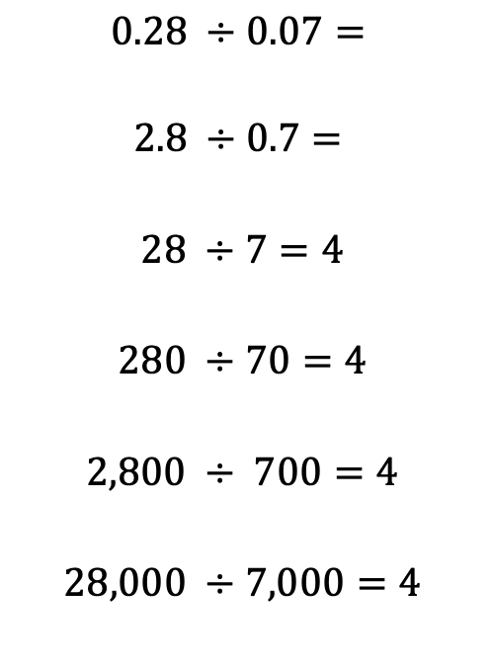
3.5.1 Warm-Up: Notice and Wonder
Several division equations are shown.
What do you wonder about the pattern?
What do you notice about the equations?
Use the pattern in the equations to determine the quotients of the first two equations.
$$0.28 ÷0.07=$$
$$2.8 ÷0.7=$$
$$28 ÷7=4$$
$$280 ÷70=4$$
$$2,800 ÷ 700=4$$
$$28,000 ÷7,000=4$$
volume 1, pg. 105
Notes:
Video Link: https://algebranation.wistia.com/medias/fi4fidi5y8

Slide 7

Guided Instruction
volume 1, pg. 105

Slide 8

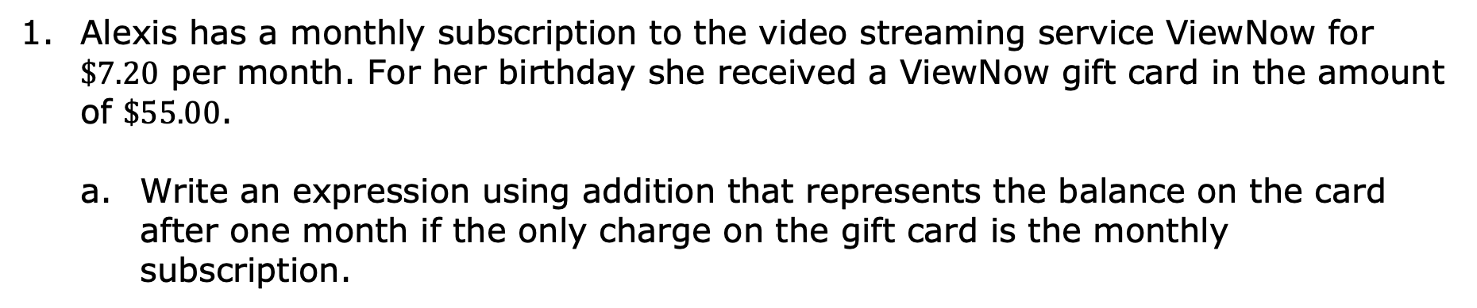
3.5.2 Guided Instruction: Adding and Subtracting Rational Numbers
Alexis has a monthly subscription to the video streaming service ViewNow for $\$7.20$ per month. For her birthday she received a ViewNow gift card in the amount of $\$55.00$.
Write an expression using addition that represents the balance on the card after one month if the only charge on the gift card is the monthly subscription.
volume 1, pg. 105

Slide 9
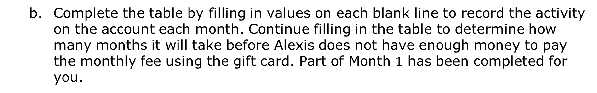
Complete the table by filling in values on each blank line to record the activity on the account each month. Continue filling in the table to determine how many months it will take before Alexis does not have enough money to pay the monthly fee using the gift card. Part of Month $1$ has been completed for you.
Month | Starting Balance | Change in Account | Ending Balance
1 | $55.00 | $55.00 + __________ | $ __________
2 | $ __________ | $ __________ + __________ | $ __________
3 | $ __________ | $ __________ + __________ | $ __________
volume 1, pg. 105

Slide 10
Month | Starting Balance | Change in Account | Ending Balance
How many months will it take before Alexis does not have enough money left on the gift card to pay the monthly charge?
volume 1, pg. 105

Slide 11
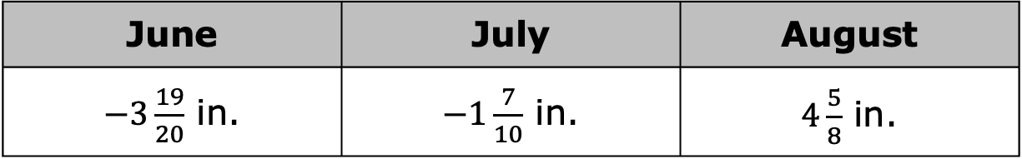
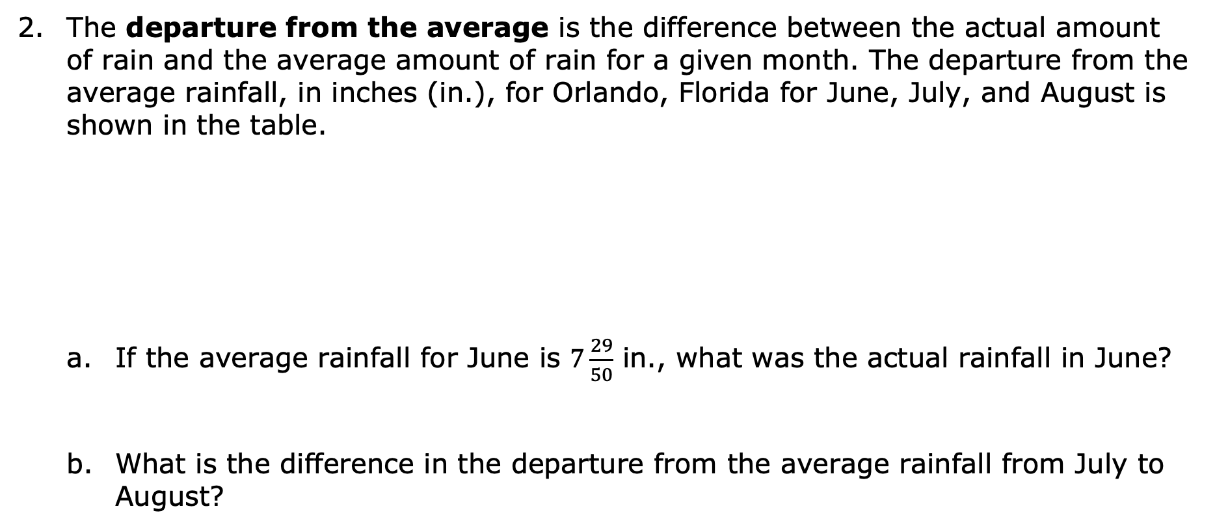
The departure from the average is the difference between the actual amount of rain and the average amount of rain for a given month. The departure from the average rainfall, in inches (in.), for Orlando, Florida for June, July, and August is shown in the table.
If the average rainfall for June is $7\frac{29}{50}$ in., what was the actual rainfall in June?
What is the difference in the departure from the average rainfall from July to August?
June | July | August
$−3\frac{19}{20}$ in. | $−1\frac{7}{10}$ in. | $4\frac{5}{8}$ in.
volume 1, pg. 106

Slide 12

Collaboration
volume 1, pg. 106

Slide 13

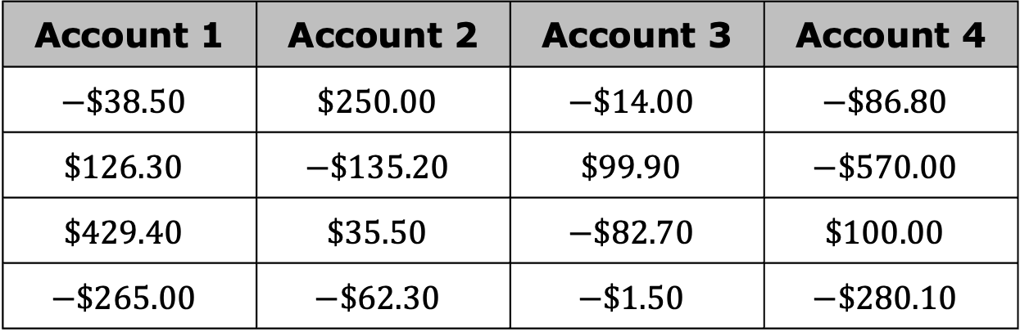
3.5.3 Collaboration: Account Transactions
The table shows transactions for four different checking accounts. A negative number represents a debit, or removing money from the account. A positive number represents a credit, or adding money to the account.
Account 1 | Account 2 | Account 3 | Account 4
$$−\$38.50$$ | $$\$250.00$$ | $$−\$14.00$$ | $$−\$86.80$$
$$\$126.30$$ | $$−\$135.20$$ | $$\$99.90$$ | $$−\$570.00$$
$$\$429.40$$ | $$\$35.50$$ | $$−\$82.70$$ | $$\$100.00$$
$$−\$265.00$$ | $$−\$62.30$$ | $$−\$1.50$$ | $$−\$280.10$$
volume 1, pg. 106

Slide 14
Work with your partner to complete the following using the information from the table.
Each checking account had the same starting balance. Without performing any calculations, discuss with your partner which account will have the most money in it after completing the transactions shown. Summarize your discussion.
volume 1, pg. 106

Slide 15
With your partner, decide who will calculate the overall change in the account balance for Accounts 1 and 2, and who will calculate them for Accounts 3 and 4. Then, find the overall change in balance for each account after applying the transactions.
Discuss with your partner which strategies you used for finding the overall change in balance for each account. Then, check your work and make any revisions if necessary.
Account 1 Balance | Account 2 Balance | Account 3 Balance | Account 4 Balance
volume 1, pg. 107

Slide 16
Which account will have the greatest final balance?
Which account will have the smallest final balance?
volume 1, pg. 107

Slide 17

Guided Practice
volume 1, pg. 107

Slide 18

3.5.4 Guided Practice: Change in Elevation
Sasha spends fall break backpacking through the beginning part of the Badwater Basin Trail in Death Valley. Her journey includes climbing up and down the hills and mountains. Sasha’s changes in elevation between each checkpoint of her trip are shown in the table.
Complete the table to determine Sasha’s change in elevation for each checkpoint. The first row has been completed to show that the change in elevation is determined by subtracting the beginning elevation from the final elevation.
volume 1, pg. 107

Slide 19
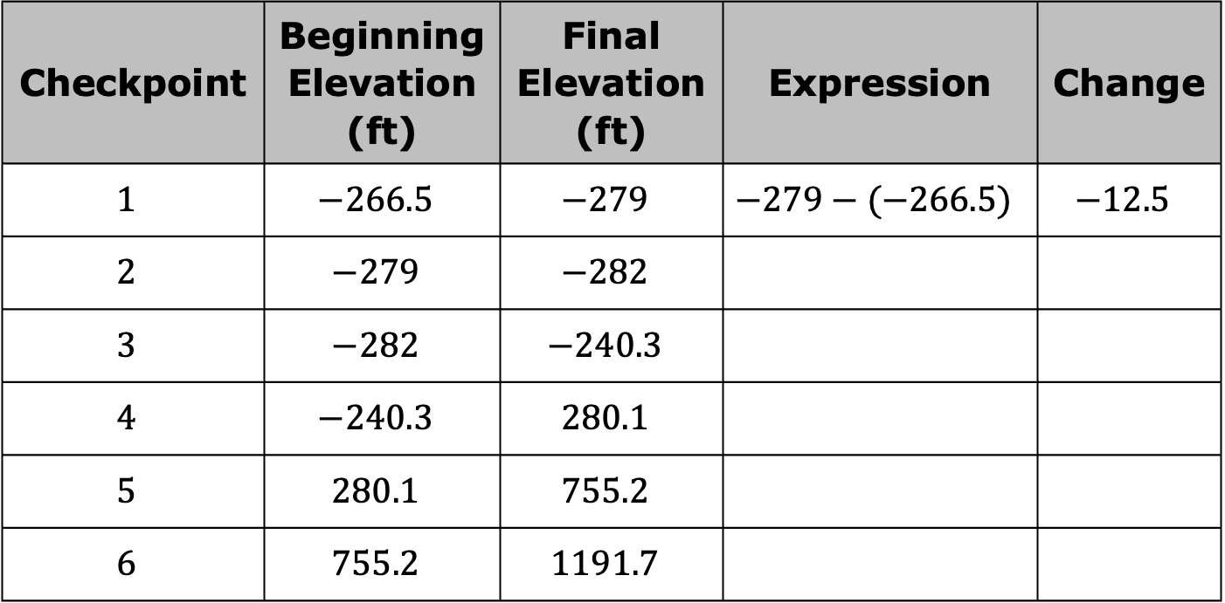
Checkpoint | Beginning Elevation (ft) | Final Elevation (ft) | Expression | Change
$$1$$ | $$−266.5$$ | $$−279$$ | $$−279−(−266.5)$$ | $$−12.5$$
$$2$$ | $$−279$$ | $$−282$$
$$3$$ | $$−282$$ | $$−240.3$$
$$4$$ | $$−240.3$$ | $$280.1$$
$$5$$ | $$280.1$$ | $$755.2$$
$$6$$ | $$755.2$$ | $$1191.7$$
volume 1, pg. 107

Slide 20
Which checkpoint had the greatest change in elevation?
What do the signs of the change in elevation mean in this context?
volume 1, pg. 107

Slide 21

Your Turn
volume 1, pg. 108

Slide 22
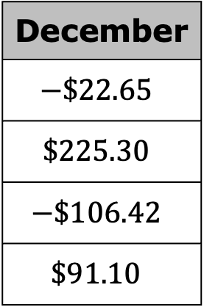
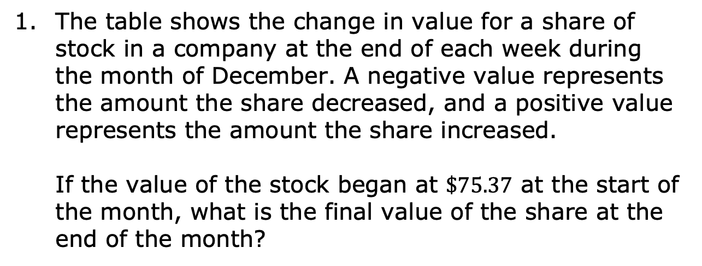
3.5.5 Your Turn!
The table shows the change in value for a share of stock in a company at the end of each week during the month of December. A negative value represents the amount the share decreased, and a positive value represents the amount the share increased.
If the value of the stock began at $\$75.37$ at the start of the month, what is the final value of the share at the end of the month?
December
$$−\$22.65$$
$$\$225.30$$
$$−\$106.42$$
$$\$91.10$$
volume 1, pg. 108

Slide 23
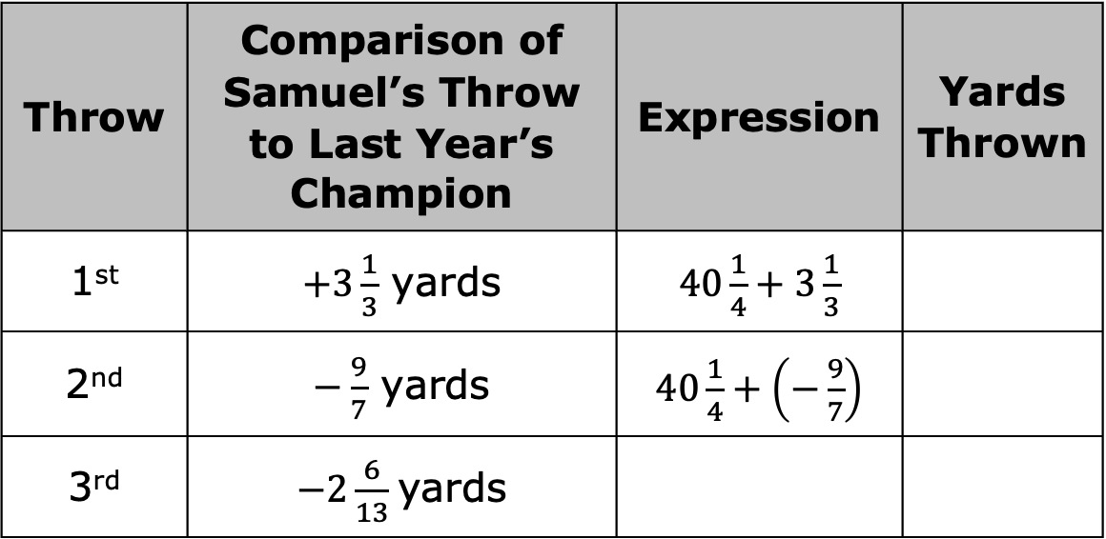
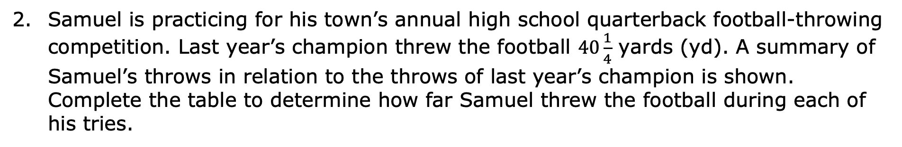
Samuel is practicing for his town’s annual high school quarterback football-throwing competition. Last year’s champion threw the football $40\frac{1}{4}$ yards (yd). A summary of Samuel’s throws in relation to the throws of last year’s champion is shown. Complete the table to determine how far Samuel threw the football during each of his tries.
Throw | Comparison of Samuel’s Throw to Last Year’s Champion | Expression | Yards Thrown
1st | $+3\frac{1}{3}$ yards | $40\frac{1}{4}+3\frac{1}{3}$
2nd | $−\frac{9}{7}$ yards | $40\frac{1}{4}+\left(−\frac{9}{7}\right)$
3rd | $−2\frac{6}{13}$yards
volume 1, pg. 108

Slide 24

Wrap-Up
volume 1, pg. 108

Slide 25
3.5.6 Wrap-Up: Growth Mindset
As you reflect on today’s lesson, circle the word Sometimes, Always, or Never to indicate how often each statement describes you.
When I work hard on a problem, I expect that the answer will be correct. | Sometimes | Always | Never
There is no point in trying to do a problem if I know I won’t get the correct answer. | Sometimes | Always | Never
Even if I made a mistake, I can still learn from working through a problem. | Sometimes | Always | Never
volume 1, pg. 108

Slide 26
I can show that I understand how to solve a problem, even if there is an error in my work. | Sometimes | Always | Never
If my answers are incorrect even after working extremely hard, I still choose to work hard on the next problem. | Sometimes | Always | Never
volume 1, pg. 108

